Slide 1
LAN
A computer network that spans a relatively small area. Most often, a LAN is confined to a single room, building or group of buildings

Slide 2
Features Of LAN
The sharing of resources
Data transfer and e-mail
Improve the reliability
Easy to distributed processing

Slide 3
Components of LANs
Network Adapter
Network Medium
Cable Connectors
Power Supply
Hub/Switch/Router
Network Software

Slide 4
LAN Standards
Network standards define guideline that specify the way computers access the medium to which they are attached.
The guideline also describe the type of medium used, the speeds used on different type of physical cable or wireless technology used
The well known standards adopted by the IEEE are 802 standards.

Slide 5
IEEE802 standards
802.3
802.7
802.8
802.11

Slide 6
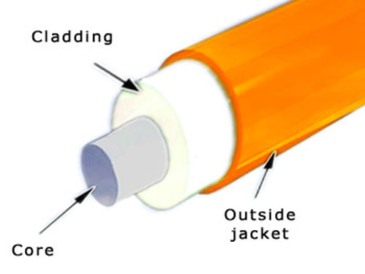
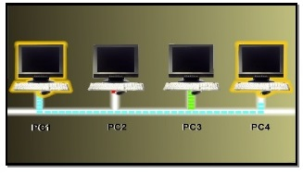
802.3 Ethernet LAN
It is the standard for an Ethernet LAN.
In 802.3, Ethernet refers to the physical cabling, while the way data is transmitted through the cable is called Carrier Sense Multiple Access/Collision Detection(CSMA/CD)
This method of transmission requires that only one device in network can transmit at a time. If another device can sense that a transmission is already in the cable, it will have to wait

Slide 7
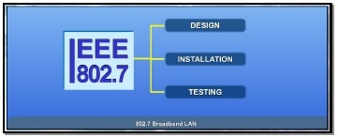
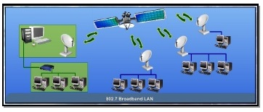
802.7 Broadband LAN
It is a Standard Specification for Broadband LAN
This 802.7 standard provides specifications for the design,installation and testing needed for broadband transmission
Broadband transmission allow simultaneous multiple transmission or signal using different communication channels at the same time

Slide 8
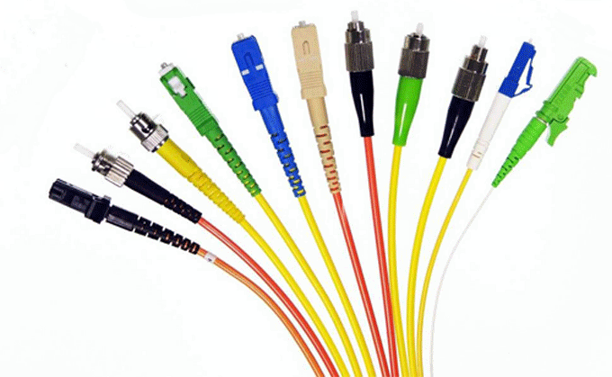
802.8 Fibre-Optic LAN and MAN
Specification for Fibre-Optic LAN and MAN are given under the 802.8 standard.
This standard gives the recommendation for the configuration and testing of fibre-optic Local Area Network and Metropolitan Area Networks

